Slide 1
Module 3
Workplace Communication

Slide 2

Module 3
Renato: esta información se presenta en con herramienta: acordeón . Esta es la información para la primera parte del acordeón . El texto del recuadro azul es el título de la primera parte del acordeón ; en el recuadro gris se anota el texto que debe mostrar. Con un complemento de imagen
Purpose
Students will develop theoretical and practical knowledge to communicate effectively and efficiently in job interviews, meetings and oral presentations at work.
Jonathan: Integrar imagen de acuerdo al texto.

Slide 3
Module 3
Renato: esta información se presenta en con herramienta acordeón
Renato: éste el título del segundo apartado del acordeón.
Generating ideas
Reflect on the following questions:
1. Have you ever asked yourself the following questions?
2. What should you do when having oral presentations?
3. What are some basic skills for effective oral presentations?
4. What skills must you develop in order to conduct effective meetings?
5. What do you need to know for holding a successful interview?
Nowadays getting a high-flying job is becoming one of the most essential objectives for everybody and specially for people who have recently finished their studies, however how can they make a skilled impression at an interview? And once they get the job what do they need to consider to present their results or conduct meetings at work? In this module, you can study and learn some significant facts to consider for those situations in the work context.
Renato: este es el contenido que ira en el segundo apartado del acordeón.
Jonathan: Integrar imagen de acuerdo al texto.

Slide 4


Module 3
Desarrollo de saberes de la Experiencia Educativa
Renato: título de sección.
3.1 Job interview
Renato: título del primer apartado de esta sección.
3.1.1. What is a job interview?
Renato: contenido del primer apartado de esta sección.
Click the button on the right to see the presentation about what a job interview is and its structure.
Aurelio: Elaborar una presentación en Genially para el siguiente apartado. Anexo información compartida por el docente para su elaboración .

Slide 5
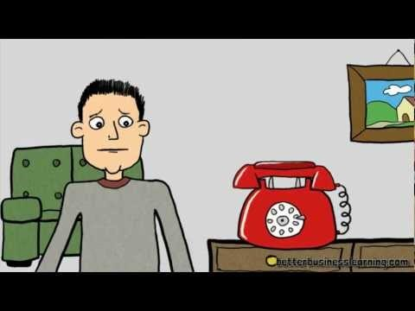
Module 3
Renato: título del segundo apartado de esta sección.
3.1.2. Essential job interview tips & techniques
Renato: contenido del segundo apartado de esta sección.
https://youtu.be/AUfe9M572as
Watch the following video where you can find some tips for an appropriate job interview.

Slide 6
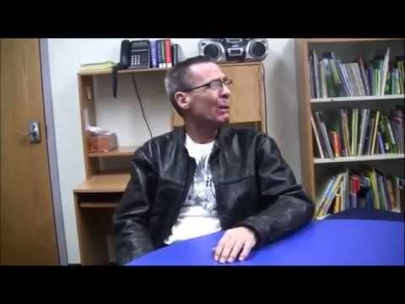
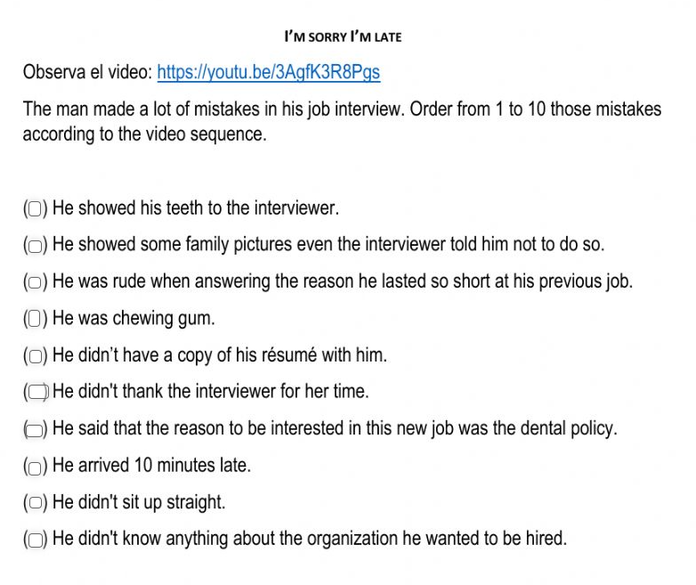
Module 3
Renato: título del tercer apartado de esta sección
3.1.3. Activity: Some errors you have to avoid in a job interview.
Watch the video and identify the errors the applicant makes.
Renato: contenido del tercer apartado de esta sección.
https://www.youtube.com/watch?v=3AgfK3R8Pgs
Instruction: According to the information from the video, do the following exercise
Renato: verificar si es posible usar un recurso de worksheet en la plataforma. Pongo este de ejemplo: https://es.liveworksheets.com/3-sm877408nu
Aurelio: si es posible que el recurso de worksheet se pueda incrustrar en la plataforma, entonces hay que realizar este ejercicio con una cuenta de la célula.

Slide 7
Module 3
Renato: título del cuarto apartado de esta sección
3.1.4. Interview through video conferencing
Click the button on the right to watch the presentation on what a video conference interview is.
Renato: contenido del cuarto apartado de esta sección.
Aurelio: Elaborar una presentación en Genially para el siguiente apartado. Anexo información compartida por el docente para su elaboración .

Slide 8
Module 3
Renato: título de sección.
3.2. Meetings
Renato: título del primer apartado de esta sección.
3.2.1. Activity: Vocabulary activity about meetings
Renato: contenido del primer apartado de esta sección.
In this module, you are going to learn about meetings, but first let's review some vocabulary related to this main topic. It's important to check meaning because a pair of them are false cognates. They don't have the meaning they seem to have, at least in this context. Guess what words are we talking about?
Vocabulary:
Meet.
Meeting.
Hold.
Outcome.
Agenda.
Minute.
Attendee.
Observe that the two words that are false cognates are:
Agenda: In this context agenda means a list of topics to be discussed at a formal meeting.
Minutes: It means a summarized record of the topics discussed at a meeting.

Slide 9

Module 3
Renato: continuación de la diapositiva anterior.
First check the meaning of the previous words in a dictionary and then choose the appropriate word to complete the following sentences:
Aurelio: elaborar una actividad de completar enunciados, puede ser en educaplay o en formato quiz de genially. Anexo información proporcionada por las maestras.

Slide 10
Module 3
Renato: título del segundo apartado de esta sección.
3.2.2. What is a meeting?
Renato: contenido del segundo apartado de esta sección.
Click the button on the right to see the content of the following presentation, there you can find what a work meeting is and how you can organize one.
Aurelio: Elaborar una presentación en Genially para el siguiente apartado. Anexo información compartida por el docente para su elaboración .

Slide 11

Module 3
Renato: título del tercer apartado de esta sección.
3.2.3. Conducting the meeting?
Renato: contenido del tercer apartado de esta sección.
Here's an infographic with some tips for running successful meetings.
Aurelio: Elaborar una infografía para este tema. En documento anexo te comparto la información proporcionada por las maestras.

Slide 12
Module 3
Renato: título del cuarto apartado de esta sección.
3.2.4. What is a agenda?
Renato: contenido del cuarto apartado de esta sección.
Click the button on the right to see the content of the following presentation, there you can find what an agenda is and how you can write one.
Aurelio: Elaborar una presentación sobre este tema. Anexo información compartida por el docente para su elaboración .

Slide 13
Module 3
Renato: título de sección.
3.3. Presentations at work
3.3.1. Activity: Identifying how to communicate effectively
Renato: título del primer apartado de esta sección.
Now solve the following exercise.
Renato: contenido del primer apartado de esta sección.
Aurelio: elaborar una actividad de relacionar en educaplay, con la información proporcionada por las maestras. Te la comparto en documento anexo.

Slide 14
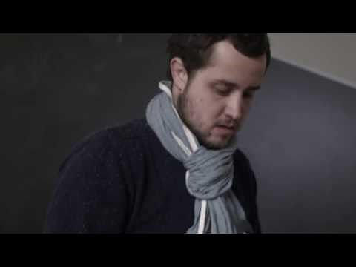
Module 3
Renato: título del segundo apartado de esta sección.
3.3.2. Effective oral presentations
Watch the next video where some suggestions to make a good presentation are given.
Renato: contenido del segundo apartado de esta sección.
https://youtu.be/Kwvil73rZV0

Slide 15
Module 3
Renato: título del segundo apartado de esta sección.
3.3.3. Actividad: Identifying how to do effective oral presentations
After watching the video The secret of effective oral presentations, match the two columns to have a summary about oral presentations.
Aurelio: elaborar una actividad de relacionar en educaplay, con la información proporcionada por las maestras. Te la comparto en documento anexo.

Slide 16
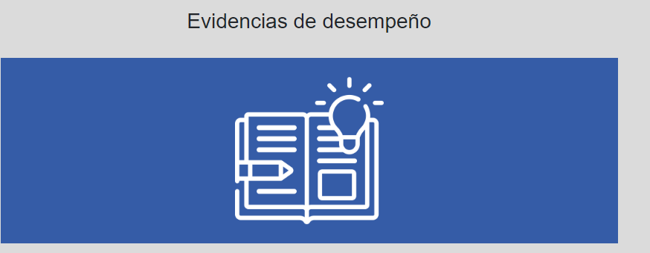
Evidence
Module 3
Project 3:
Video of a presentation of a topic or a job interview
Description:
Participants can choose to make a video of a presentation of a topic or a job interview mastering what they studied in this module.
Evaluation criteria:
Participants’ script must:
Have clarity of purpose and thought.
Convey accurate, relevant and complete information.
Have short, concise and clear ideas.
Have correct grammar and appropriate vocabulary
Participants’ video must:
Run well (sound and image).
Last between 2 or 3 minutes.
Be recorded in mp4 format.

Slide 17
Evidence
Module 3
Guidelines:
Short oral presentation
Participants choose a common topic from their area (one they could present soon if they work) or a topic they may present when working in a company.
Participants write their script.
Participants choose, organize and use their visual aids when presenting their topic.
Participants, when ready, make a video of their oral presentation(taking into account all the aspects for successful oral presentations).
Participantes record their video as if they were in front of their colleagues.
It can be between 2 to 3 minutes long in an mp4 format.
Participants upload or share the link of their video.
Job interview
Participants choose five of the following examples and prepare their answers:
Tell me about yourself.
What is your greatest strength?
Can you describe a situation in your past where you learned from a mistake?
What is the most difficult (job) situation you have ever faced?
Is there anything you would like to improve about yourself?
What is the most important thing you are looking for in a job?
What are your career goals?
What motivates you?
Why would you like to work for us?
Why should I hire you?
Before recording your video
1. Participants rehearse their answers, paying attention to verbal communication and body language.
2. They may also pay attention to the pieces of advice given in module 3 for interviews.
3. When ready, participants make a video simulating they are in a job interview.
They upload their video or share the link
1. Name your file as follows: Actn_LastNameandFirstName. For example: Act3_VillanuevaMariaTeresa.
2. Send your file, in Word format, PDF or PPT via Activities tool in Eminus platform, no later than the due date set in the Course calendar.
Renato: esta información es continuación de la diapositiva anterior.

Slide 18
Module 3
References
Basic references
Alred, G., Brusaw, C. T. & Oliu, W. E. (2009). Handbook of Technical writing. Ninth edition. Bedford. http://site.iugaza.edu.ps/mahir/files/2017/01/Handbook-of-Technical-Writing-9th-Edition.pdf
ESLLearning. (2015, May 11). Job Interview: Sorry I'm Late. [Video]. YouTube. https://youtu.be/3AgfK3R8Pgs
InfotrackUNIGE. (2018, March 1). The secret to effective presentation slides. [Video]. YouTube. https://youtu.be/Kwvil73rZV0
S. a. (s. f.). Business communication. https://ddceutkal.ac.in/Syllabus/MA_English/Paper_21.pdf
S. a. (s. f.). Phrasal Verbs for Meetings. https://studylib.net/doc/7528169/22.-phrasal-verbs-for-meetings.
Job interview. (2022). Vocabulary.com. Retrieved on July 19, 2020, from: https://www.vocabulary.com/dictionary/job%20interview
Wedell, G. (2012, May 20 ). Essential Job Interview Tips & Techniques. [Video]. YouTube. https://youtu.be/AUfe9M572as

Slide 19
Module 3
Additional references
Chand, S. (s. f.). Meetings: Types, Purpose, Advantages and Disadvantages. Your article LibraryThe Next Generation Library. https://www.yourarticlelibrary.com/business-communication/meetings-types-purpose-advantages-and-disadvantages/27671
SKILLSYOUNEED (s. f.). Planning and Structuring Effective Meetings. Helping you Develop Life Skills. https://www.skillsyouneed.com/ips/meetings.html
SKILLSYOUNEED (s.f.). Helping you Develop Life Skills Agenda-setting for meetings. Helping you Develop Life Skills. https://www.skillsyouneed.com/ips/agenda-setting.html
Lexico (s. f.). Report preparation. Lexico.com. https://www.lexico.com/grammar/report-preparation

